Slide 1

CS 533 INTRO TO DATA SCIENCE
Michael Ekstrand

Slide 2
BIASES AND ASSUMPTIONS

Slide 3
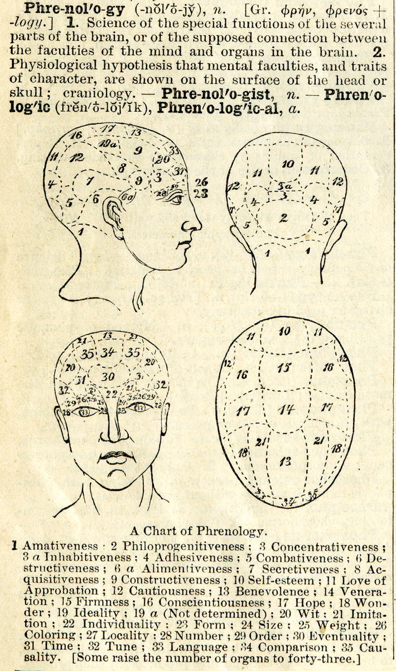
Learning Outcomes
Reason about potential biases in classification inputs and outputs
Identify cases where building a classifier is not appropriate

Slide 4
Assumptions of Most Predictions
Outcome variable is unbiased
Features unbiased
Outcome variable matches target
Predicting this outcome with these features is reasonable
Think about what the predictor implies

Slide 5
A Few Sources of Bias (Week 2)
Selection bias
Some people more likely to be contacted
Response bias
Some people are more likely to respond
Measurement bias
Measurement skews one way or another

Slide 6
Error and Bias
Observations are often erroneous.
Bias is when they are systematically erroneous.
Tend high or low
May be different for different groups

Slide 7
Biased Features
If features are unbiased ⇒ errors roll into model uncertainty
If they have known bias ⇒ may be able to correct
Remove bias term
Normalize by groups?
Unknown bias ⇒ how severe? (may need to abandon!)

Slide 8
Assumptions
Example: SAT scores — differ by SES (socio-economic status)
What’s more likely?
Poor students are less academically capable
Poor students have less access to academic preparation
The SAT measures both academic capability and familiarity with middle- to upper-class social conventions

Slide 9

Outcome/Target Mismatch
Aren’t predicting what we think we are
Example: crime
Data: crime reports or arrests
Goal: predict crime level
Reality: predict crime report level or police activity
Photo by Woody Kelly on Unsplash

Slide 10
Claims and Evidence
Our claims must be supported by our evidence
Can’t claim a crime detector when our data is crime reports
This is why the goal ⇔ question ⇔ analysis chain is critical!

Slide 11
Task Reasonableness
What does trying to predict Y with X inherently assume?
Predict college GPA with SAT scores
Performance on a standardized test is legitimate basis for predicting future academic grades
Classifying ‘criminal’ based on photos
Facial features are a legitimate predictor of criminality
This is called ‘physiognomy’, and has been rejected for a century
Related: ‘phrenology’, connecting personality to skull shape

Slide 12
Crime/Face Correlation
What is crime?
Why would it be a physically observable characteristic?
Be careful what you assume
Theory drives research questions
Theory drives predictions

Slide 13
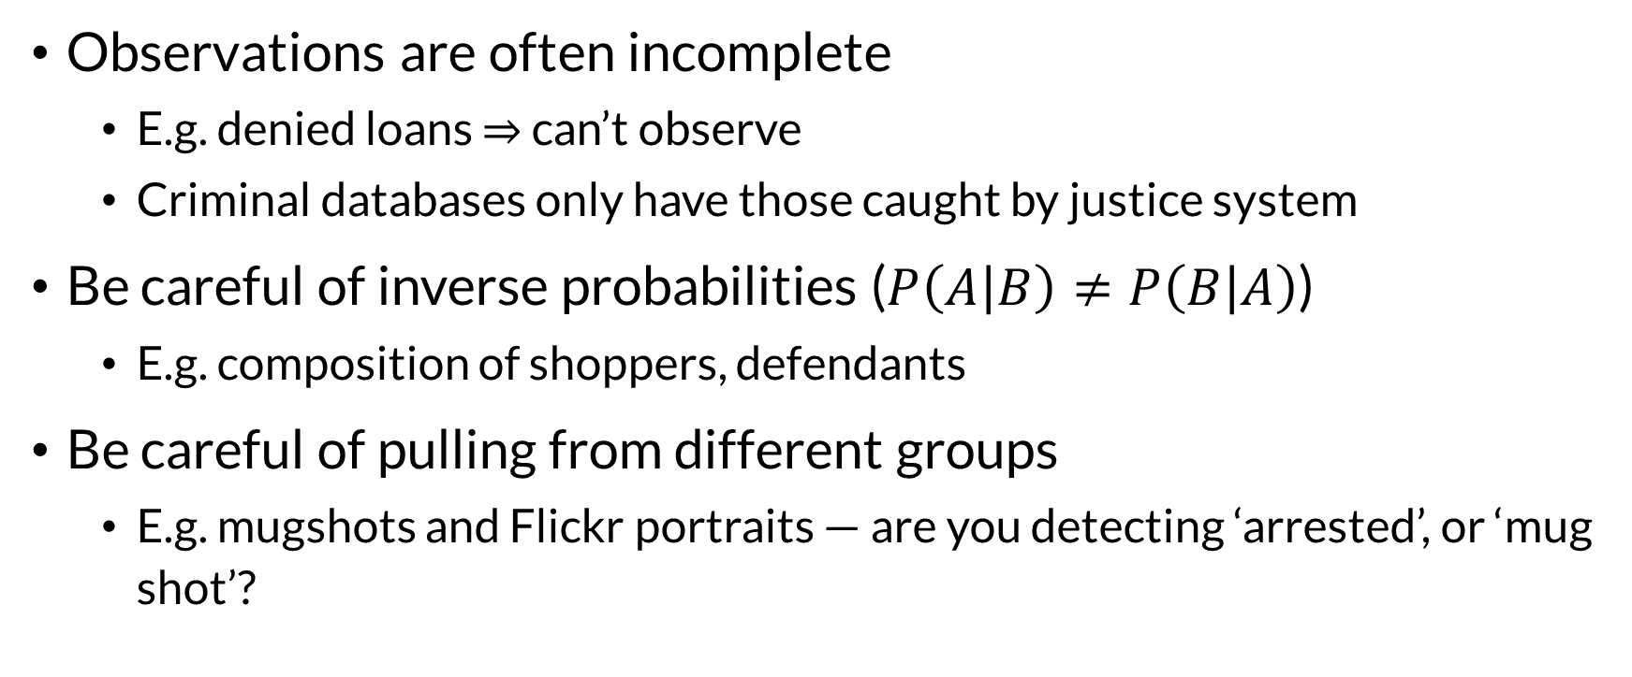
Label Dependencies
Observations are often incomplete
E.g. denied loans ⇒ can’t observe
Criminal databases only have those caught by justice system
Be careful of inverse probabilities ($P\left(A | B\right)≠P\left(B | A\right)$)
E.g. composition of shoppers, defendants
Be careful of pulling from different groups
E.g. mugshots and Flickr portraits — are you detecting ‘arrested’, or ‘mug shot’?

Slide 14
What to Do?
Assume data is biased (especially social data)
Understand how the data is collected and what labels actually are
Study what is known about those biases
Look for systematic variations in the data
Clarify and document your assumptions
Always be critical — does problem or outcome make sense?
Read broadly and critically

Slide 15
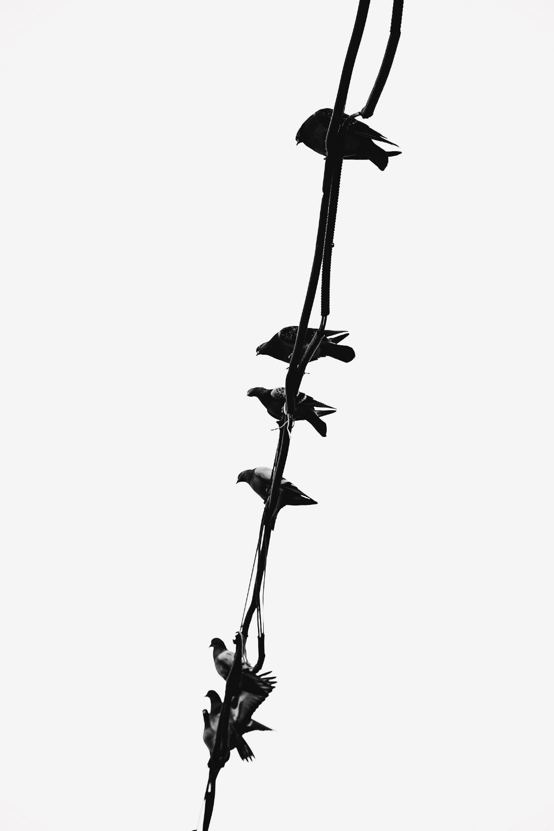
Wrapping Up
All analyses are based on assumptions — be clear about what yours are.
Data are biased. Study to see how.
There’s no magic bullet.
Photo by Parizad Shojaei on Unsplash

